Slide 1
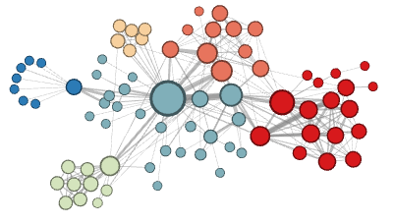
Why do your ego networks look they way they do?
The composition of your ego network is likely biased
  How are your ego networks biased?
    Some kinds of people are over-represented in your ego-network
    Some kinds of people are under-represented in your ego network
    The people who are over-represented are more likely to be similar to you
    The people who are under-represented are more likely to be dissimilar to you
      These last two things are the basis of homophily*
*McPherson, M., Smith-Lovin, L., & Cook, J. M. (2001). Birds of a feather: Homophily in social networks. Annual Review of Sociology, 27(1), 415-444.

Slide 2
Why do your ego networks look they way they do?
In what ways are your networks biased toward homophily?
  According to pretty much any social distinction we can think of*
    Gender
    Race/Ethnicity
    Education
    Age
    Occupation/Income
  These are what Peter Blau called “dimensions of association”
    Some of these are “categorical”
      Like race , gender or occupation
    Some are “continuous”
      Like age, education or income

Slide 3

Why do your ego networks look they way they do?
Why are your ego networks biased toward homophily?
  One obvious source of bias is what has been called* choice homophily
    You like to hang out with people who are similar to you (regardless)
  One non-obvious source of bias is what has been called* induced homophily
    The social context (nation, state, organization) where you reside determines the people who are available for you to hang out with
*McPherson, J. M., & Smith-Lovin, L. (1987). Homophily in voluntary organizations: Status distance and the composition of face-to-face groups. American Sociological Review, 370-379.
Peter Blau (1918 - 2002)

Slide 4
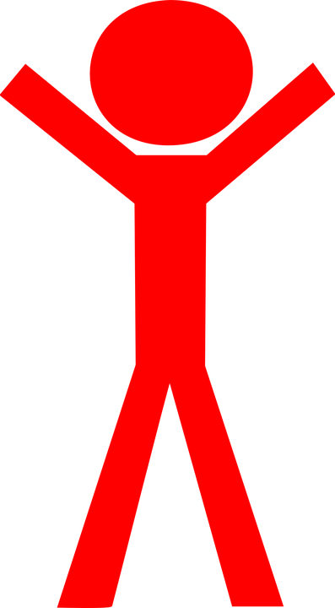
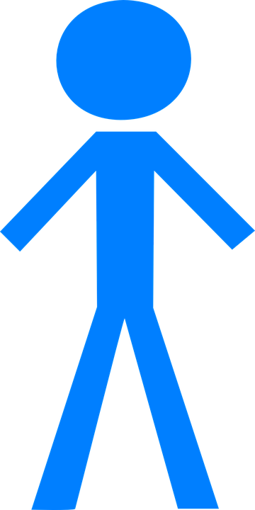
Why do your ego networks look they way they do?
The World
Your ego network
Peter Blau (1918 - 2002)
Unbiased
Biased

Slide 5
Why do your ego networks look they way they do?
The World
Your ego network
Peter Blau (1918 - 2002)
Unbiased
Biased

Slide 6
Why do your ego networks look they way they do?
The World
Your ego network
Peter Blau (1918 - 2002)
Unbiased
Biased

Slide 7
Why do your ego networks look they way they do?
The World
Your ego network
Peter Blau (1918 - 2002)
Unbiased
Biased

Slide 8
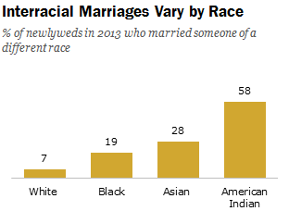
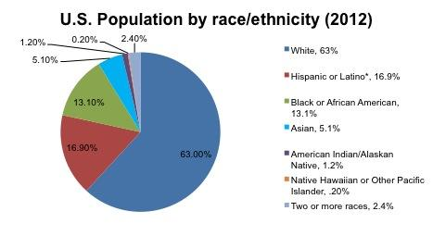
Blau’s rules: Group size effects
If a categorical dimension divides the population into two or more groups:
  Rule 1: Members of numerically smaller groups will be more likely to have relations with outgroup members
  Rule 2: Members of numerically larger groups will be more likely to have relations with ingroup members
    These are called group size effects

Slide 9

Focused organizations of social ties
One observation:
  Often social relations are organized around “circles,” or “common activities”
  These “foci” may themselves be a primary driver of which relations show up in people’s networks
What is a “focus”?
  “ a social, psychological, legal, or physical entity around which joint activities are organized (e.g., workplaces, voluntary organizations, hangouts, families, etc.” (Feld 1981: 1016)

Slide 10


Focused organizations of social ties
This suggests two new mechanisms for where ties come from:
From circle to relation
From common activity to relation

Slide 11
Focused organizations of social ties
Foci vary around several dimensions
  Levels of “constraint”
    Time and energy that they require
  Size
Foci may emerge from pre-existing relations
  Friends form clubs, participate in common activities
Individuals generally belong to multiple intersecting foci
  “Cross-cutting” circles
  Clustering at the ego-network level may be the result of constraining overlapping foci

Slide 12
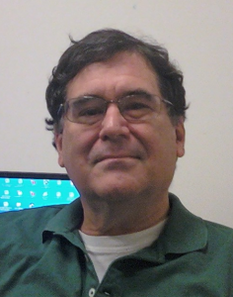
Why do your ego networks look they way they do?
Church
Family
School
You
Scott Feld
Unbiased!

Slide 13
Why do your ego networks look they way they do?
Church
Family
School
You
Scott Feld
Unbiased!

Slide 14
Why do your ego networks look they way they do?
The typical settings within which you interact as reference for bias:
  Feld Rule: If the settings within which you interact are biased towards a particular categorical or continuous dimension of association your ego-network will reflect that bias
    Feld referred to these settings as social foci
    Therefore, this is the called the focus effect
      Foci make homophily happen via segregation
    Conversely,
      Desegregated foci reduce homophily
Scott Feld

Slide 15
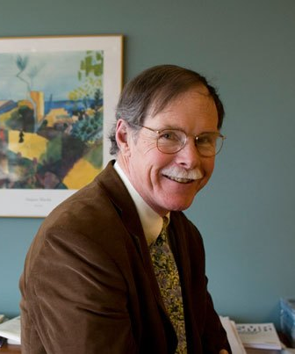
Why do your ego networks look they way they do?
The World
Your ego network
Small
Large
Peter Marsden
More biased
Less Biased

Slide 16
Why do your ego networks look they way they do?
Overall, larger ego networks should be more diverse
  Regardless of preferences for choice homophily
    At some point you run out of ingroup alters!
But this effect should depend group size effects
  In general, minorities should get more “bang from their buck” (in terms of diversity) from network size
    Can you tell why?
Peter Marsden

Slide 17
Why do your ego networks look they way they do?
Overall, larger ego networks should be more diverse
  Regardless of preferences for choice homophily
    At some point you run out of ingroup alters!
But this effect should depend group size effects
  In general, minorities should get more “bang from their buck” (in terms of diversity) from network size
    Can you guess why?

Slide 18
Why do your ego networks look they way they do?
Overall, larger ego networks should be more diverse
  Regardless of preferences for choice homophily
    At some point you run out of ingroup alters!
But this effect should depend group size effects
  In general, minorities should get more “bang from their buck” (in terms of diversity) from network size
    Can you tell why?
A
B

Slide 19

Why do your ego networks look they way they do?
A
B

Slide 20

Blau’s rules: Multiform heterogeneity effects
Example:
  In the U.S. there are systematic correlations between religion and race
This means that:
  Choosing contacts based on race leads to biases in the representation of people of certain religions at the micro-structural level (And vice-versa)
Accordingly:
  Can’t conclude that people prefer same (race/religion) contacts from micro-level observations of homogeneity!

Slide 21
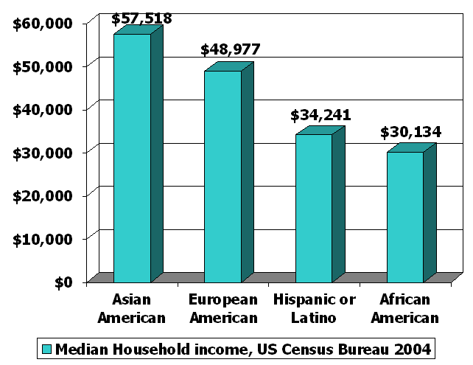
Blau’s rules: Multiform heterogeneity effects
This applies to any correlation between dimensions of association
  Same race associational preference may lead to higher/lower representation of people different social classes at the micro-structural level
With negative correlations it goes the other way
  More diversity at the micro-level that we would expect
    E.g. Age and education

Slide 22
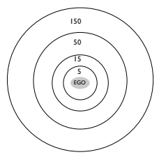
How are ego networks organized?
Anthropologist Robin Dunbar:
  Ego-networks are organized by layers
    “Closer” more intimate layers
    “Farther” less intimate ones
  Closer layers are smaller
  Farther layers are larger
  Different relationships entails different “maintenance costs”
  Costs determine the number of persons in each layer
    Support clique
    Sympathy group
    Affinity group
    Active Network

Slide 23
How are ego networks organized?
Anthropologist Robin Dunbar:
  Support clique (~ 4 - 5)
    Your most intimate “best” friends and kin you can rely on them for crises and emergencies
  Sympathy group (~12 - 15)
    Good friends that can provide some services and that you contact often
  Affinity group (~ 45 - 50)
    More casual, “hang out” friends and extended relatives
  Active Network (~120 - 150)
    Total number people you contact or see at least once a year, acquaintances

Slide 24
How are ego networks organized?
Anthropologist Robin Dunbar:
  Support clique (~ 4 - 5)
    Your most intimate “best” friends and kin you can rely on them for crises and emergencies
  Sympathy group (~12 - 15)
    Good friends that can provide some services and that you contact often
  Affinity group (~ 45 - 50)
    More casual, “hang out” friends and extended relatives
  Active Network (~120 - 150)
    Total number people you contact or see at least once a year, acquaintances
Sarah | 12
Cass | 15
Shannon | 12
Pete | 15
Joseph | 13
Madeleine | 13
Marissa | 13
Kelly | 12
Allison | 11
Katherine | 10
Elizabeth | 10
Ethan | 6
Jessica | 9
Claire | 14
Steve | 12
Allison | 10
Alexandra | 9
Caroline | 18
Average | 12

Slide 25
How are ego networks organized?
Anthropologist Robin Dunbar:
  Support clique (~ 4 - 5)
    Your most intimate “best” friends and kin you can rely on them for crises and emergencies
  Sympathy group (~12 - 15)
    Good friends that can provide some services and that you contact often
  Affinity group (~ 45 - 50)
    More casual, “hang out” friends and extended relatives
  Active Network (~120 - 150)
    Total number people you contact or see at least once a year, acquaintances
Sarah | 12
Cass | 15
Shannon | 12
Pete | 15
Joseph | 13
Madeleine | 13
Marissa | 13
Kelly | 12
Allison | 11
Katherine | 10
Elizabeth | 10
Ethan | 6
Jessica | 9
Claire | 14
Steve | 12
Allison | 10
Alexandra | 9
Caroline | 18
Average | 12

Slide 26
Blau’s rules: Group size effects
Implications of the group size effect:
  Ingroup dominated networks of majority group members not necessarily a sign of choice homophily
    Could just be induced homophily

